Slide 1


Inicio
Student Learning Assessment Results at the Undergraduate Level of the University of Puerto Rico Río Piedras Campus: Academic Year 2025–2026
Prepared by:
Dr. Emmanuel Ocasio Acevedo
Institutional Coordinator for Student Learning Assessment
Undergraduate Level
June, 2026
1
Notes:
RESULTADOS DE AVALÚO DEL APRENDIZAJE ESTUDIANTIL EN EL NIVEL SUBGRADUADO DE LA UNIVERSIDAD DE PUERTO RICO RECINTO DE RÍO PIEDRAS AÑO ACADÉMICO 2025-2026
Traducir al inglés

Slide 2
Introduction
4
This report brings together the charts that illustrate the results of the Undergraduate Student Learning Assessment for the Río Piedras Campus corresponding to the 2025–2026 academic year. The information comes from the academic programs that document their processes and findings in the Online Learning Assessment System (OLAS). This document reflects a sustained institutional effort to strengthen assessment as a continuous process that fosters collective reflection and guides academic decision‑making grounded in data.
It is essential to acknowledge the dedication of the coordinators of learning assessment across the various units of the Campus, as well as the faculty. The work carried out by each of them has been key to making this effort possible, to continuing to cultivate a culture of assessment within the Campus, and to promoting the ongoing improvement of the student learning process based on data.
Prepared by:
Dr. Emmanuel Ocasio Acevedo
Institutional Coordinator for Student Learning Assessment
Undergraduate Level
June 6, 2026
Notes:
Este informe reúne las gráficas que ilustran los resultados del Avalúo del Aprendizaje Estudiantil Nivel subgraduado del Recinto de Río Piedras correspondientes al año académico 2025‑2026. La información proviene de los programas académicos que documentan sus procesos y hallazgos en la plataforma Online Learning Assessment System (OLAS). Este documento da cuenta de un esfuerzo institucional sostenido por fortalecer el avalúo como un proceso continuo que impulsa la reflexión colectiva y orienta las decisiones académicas fundamentadas en datos.
Es menester reconocer la dedicación de las personas coordinadoras del avalúo del aprendizaje de las diversas unidades del Recinto y del personal docente. La labor realizada por cada una de ellas ha sido clave para hacer posible este ejercicio, para seguir cultivando una cultura de avalúo en el Recinto y promover la mejora constante del proceso de aprendizaje estudiantil basada en datos.
Preparado por:
Dr. Emmanuel Ocasio Acevedo
Coordinador institucional de avalúo del aprendizaje estudiantil Nivel Subgraduado
__ de junio de 2026

Slide 3
Content - Academic Units
4
General Education Component:
Business Administration
Architecture
Natural Sciences
Social Sciences
General Studies
Communication and Information
Humanities
Education: Did not report data.
Business Administration: Reported data.
Architecture: Did not report data.
Natural Sciences: Did not report data.
Social Sciences: Did not report data.
General Studies: Reported data.
Humanities: Reported data.

Slide 4




Inicio
Business Administration
2025-2026
3

Slide 5
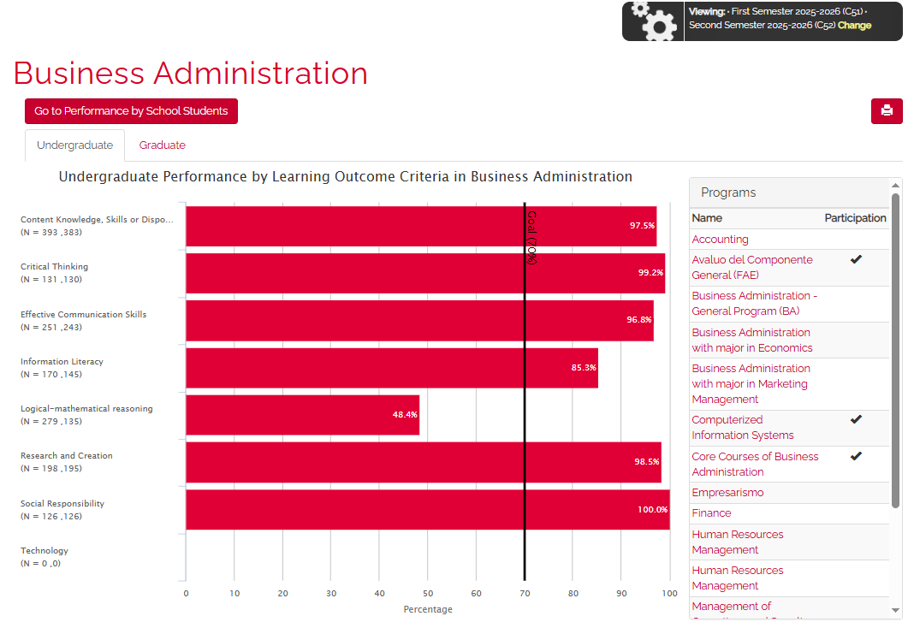
College/school results: Business Administration (C51 & C52)
Inicio
4

Slide 6
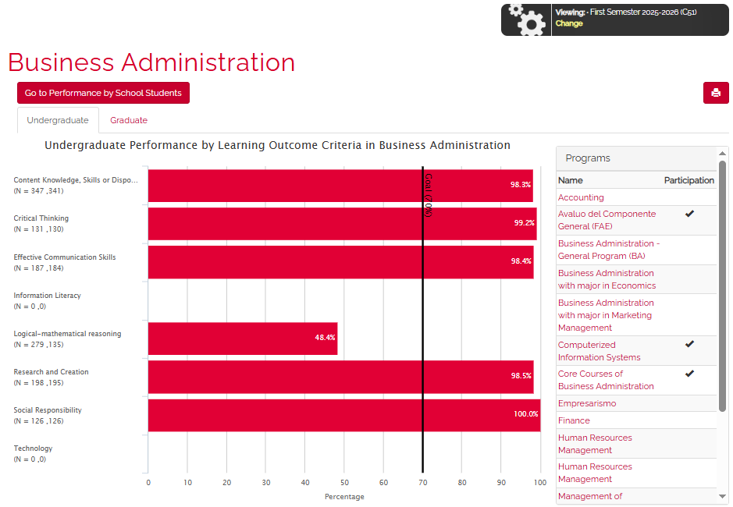
College/school results: Business Administration (C51)
Ir a inicio
4

Slide 7
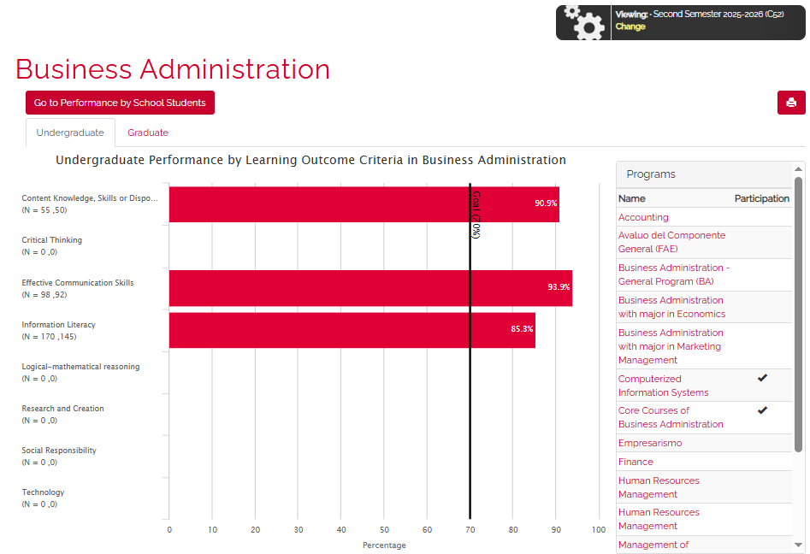
College/school results: Business Administration (C52)
Ir a inicio
4

Slide 8
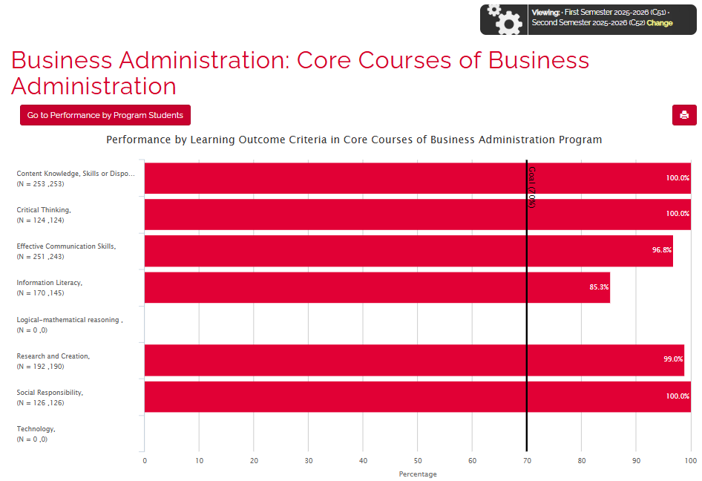
Core Courses: Business Administration (C51 & C52)
Ir a inicio
5

Slide 9
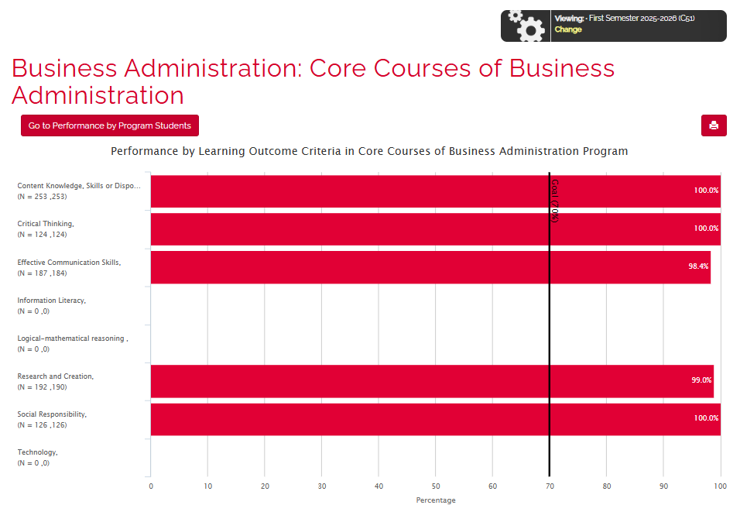
Core Courses: Business Administration (C51)
Ir a inicio
6

Slide 10
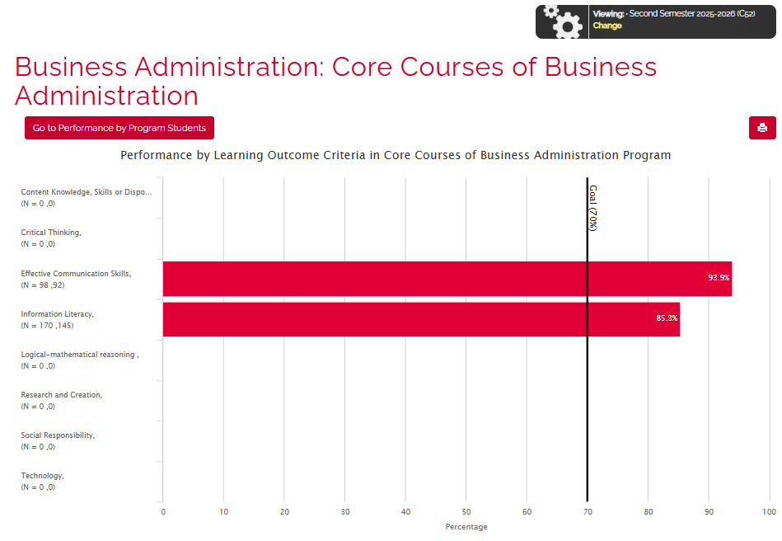
Core Courses: Business Administration (C52)
Ir a inicio
7

Slide 11
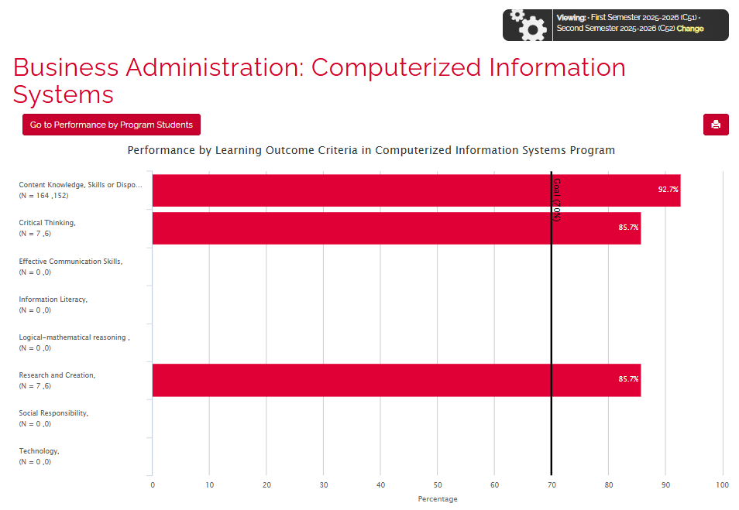
Business Administration: Computerized Information Systems
(C51 & C52)
Ir a inicio
8

Slide 12
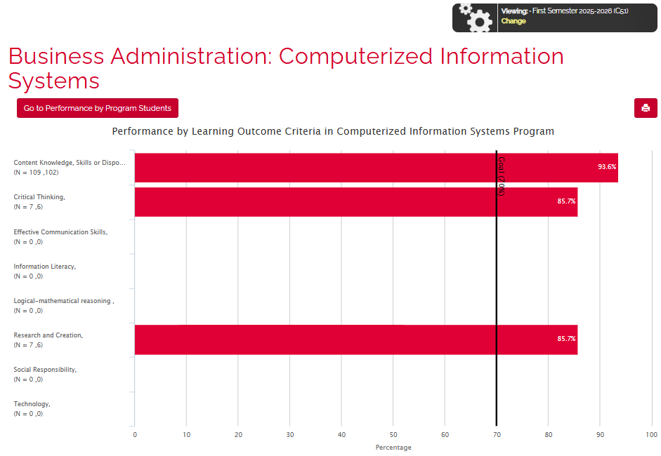
Business Administration: Computerized Information Systems (C51)
Ir a inicio
9

Slide 13
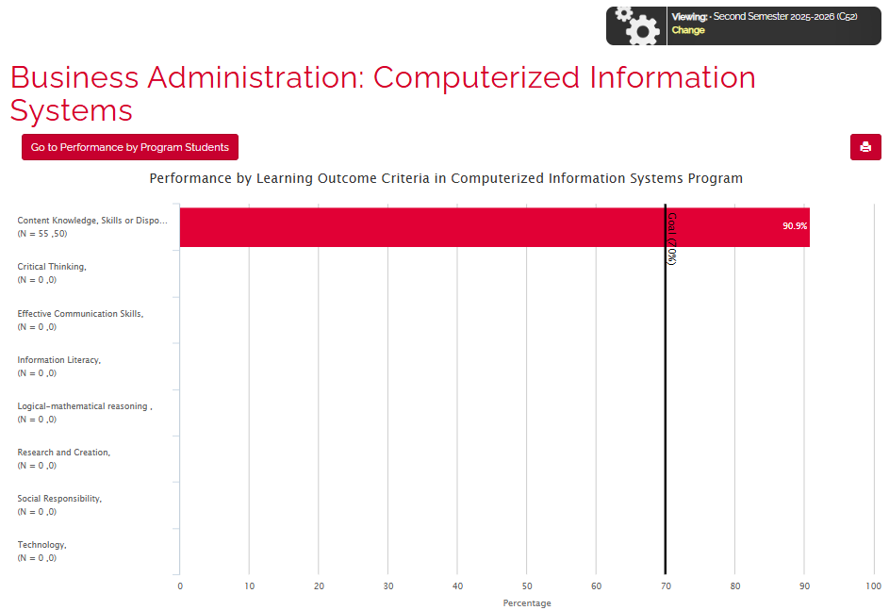
Business Administration: Computerized Information Systems (C52)
Ir a inicio
10

Slide 14
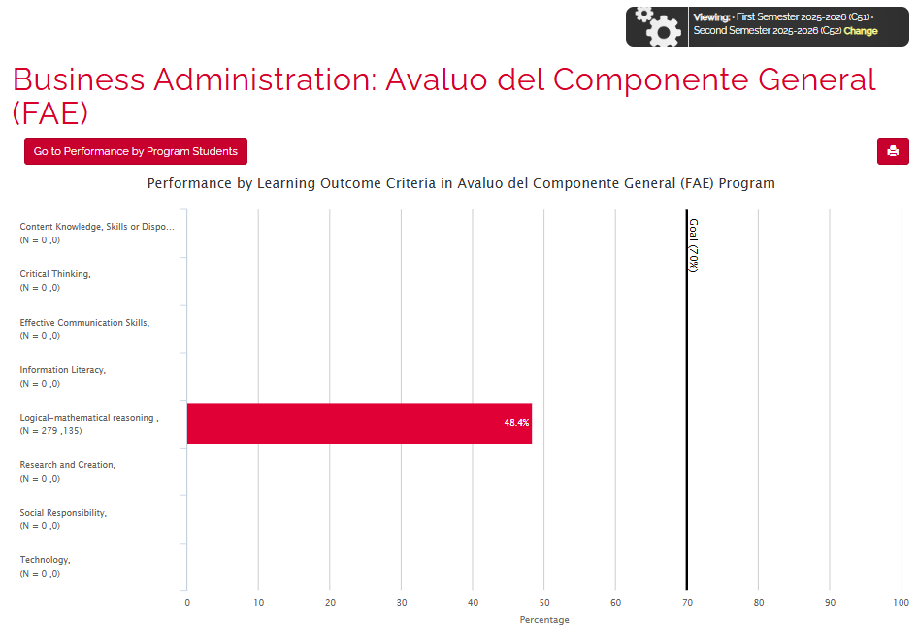
Business Administration: Avalúo del Componente General
(C51 & C52)
Ir a inicio
10

Slide 15
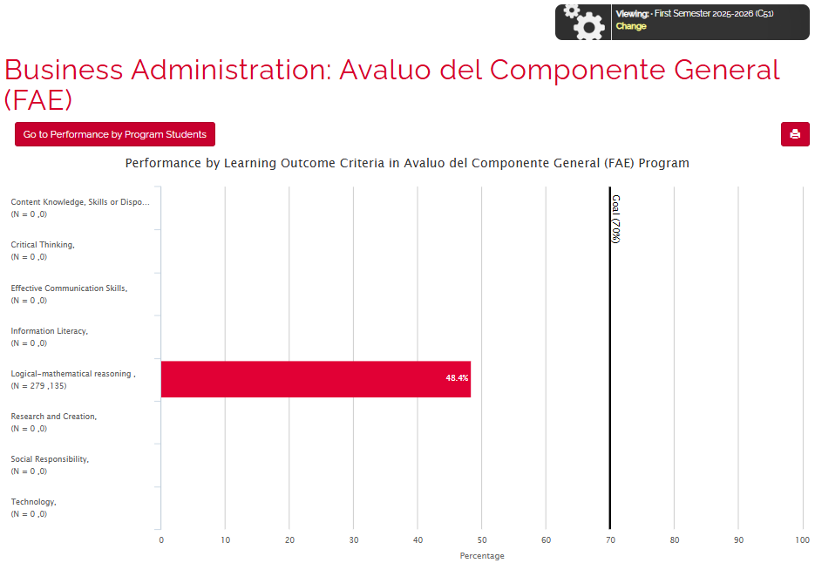
Business Administration: Avalúo del Componente General (FAE)
(C51)
Ir a inicio
10

Slide 16
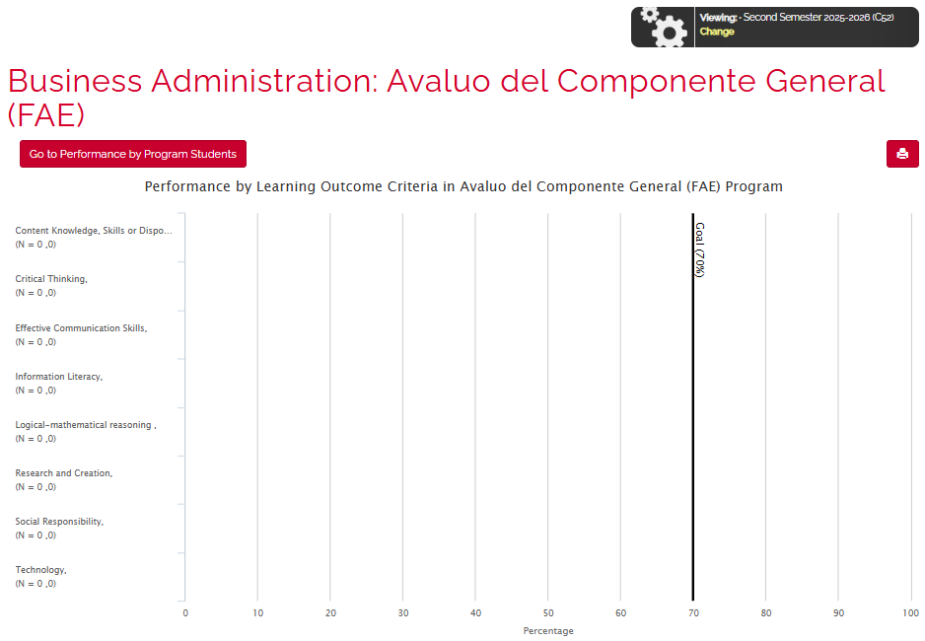
Business Administration: Avalúo del Componente General (FAE)
(C52)
Ir a inicio
10

Slide 17

Ir a inicio
Architecture
2025-2026
11

Slide 18
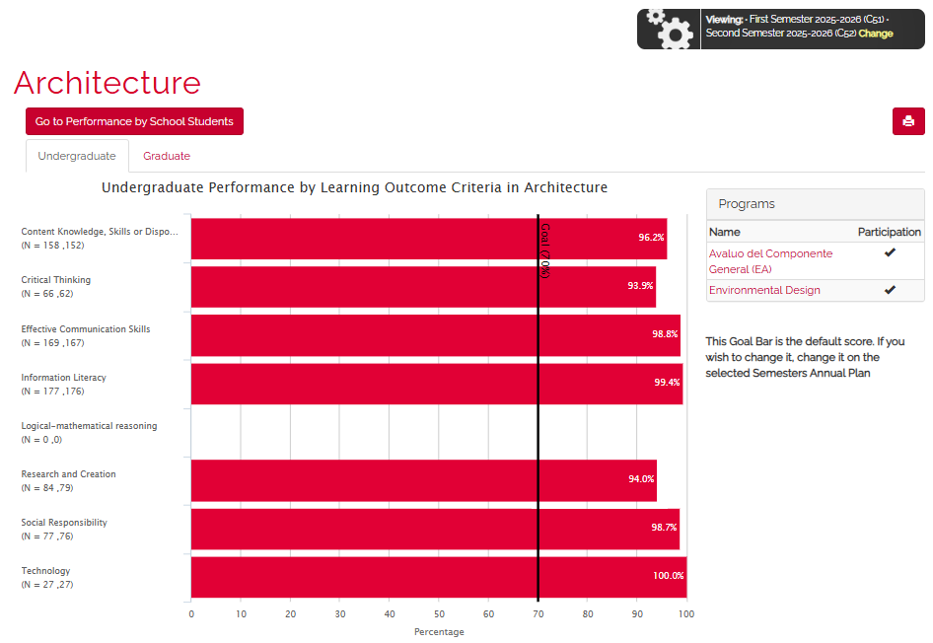
College/school results: Architecture (C51 & C52)
Ir a inicio
12

Slide 19
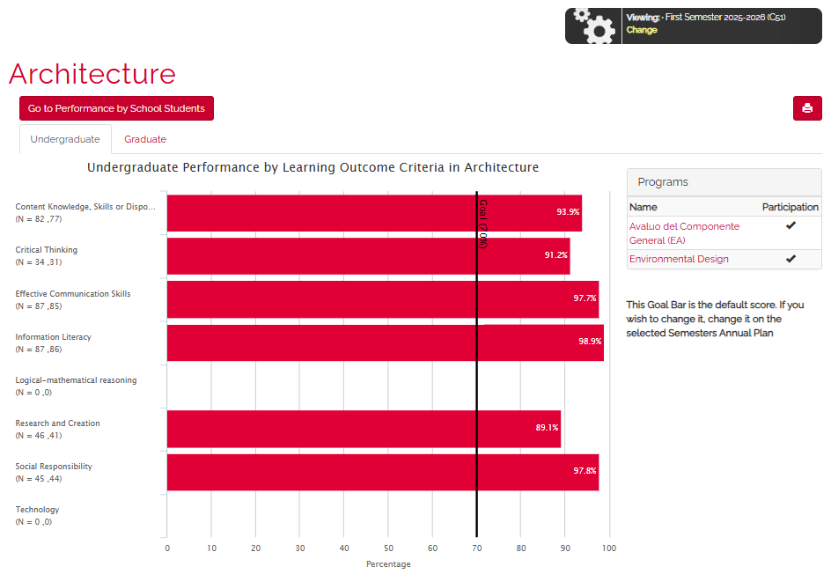
College/school results: Architecture (C51)
Ir a inicio
12

Slide 20
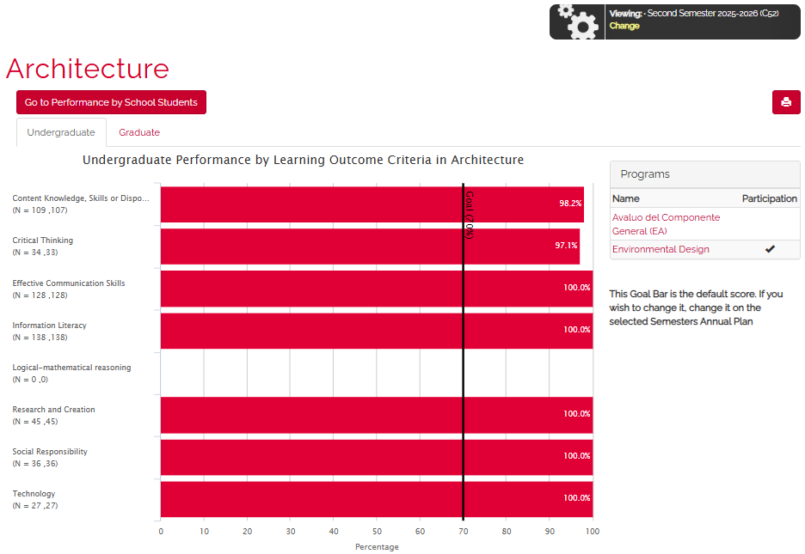
College/school results: Architecture (C52)
Ir a inicio
12

Slide 21
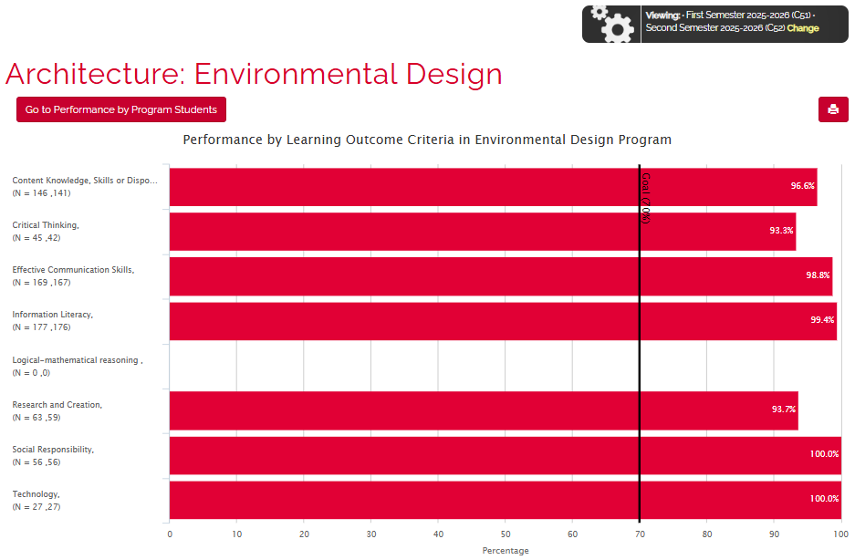
Architecture: Environmental Design (C51 & C52)
Ir a inicio
13

Slide 22
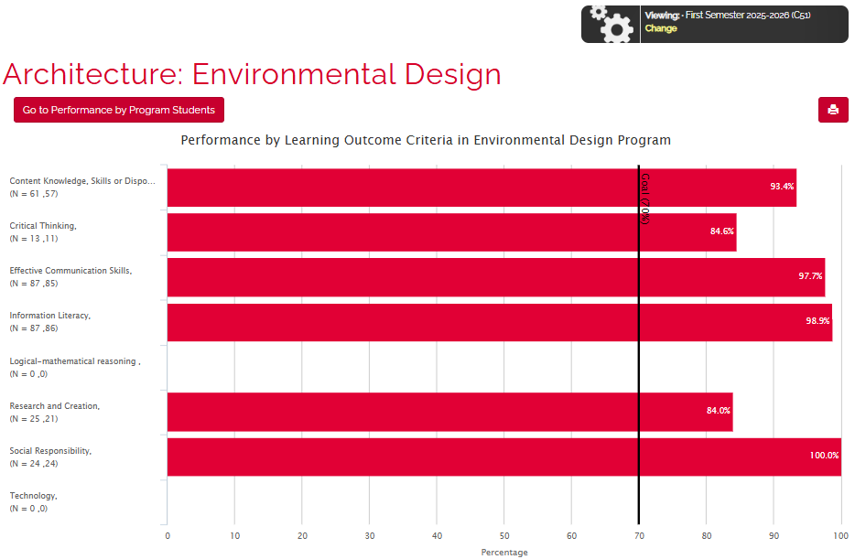
Architecture: Environmental Design (C51)
Ir a inicio
13

Slide 23
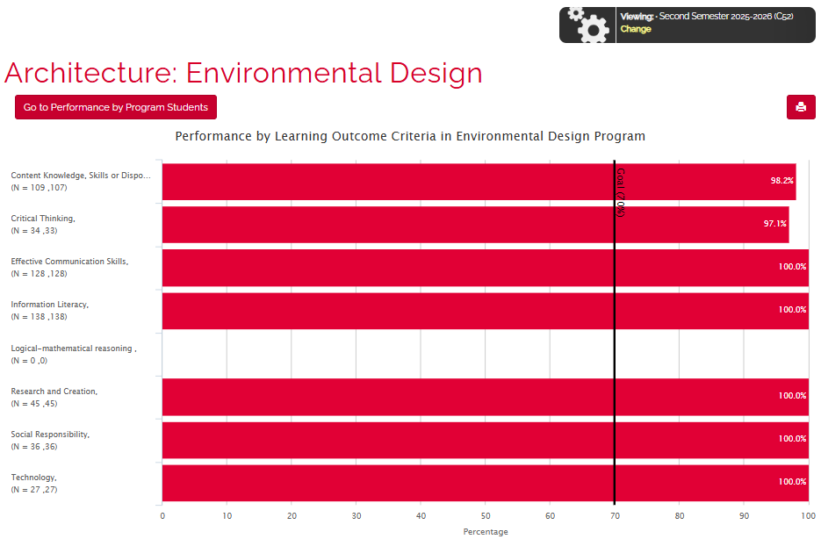
Architecture: Environmental Design (C52)
Ir a inicio
14

Slide 24
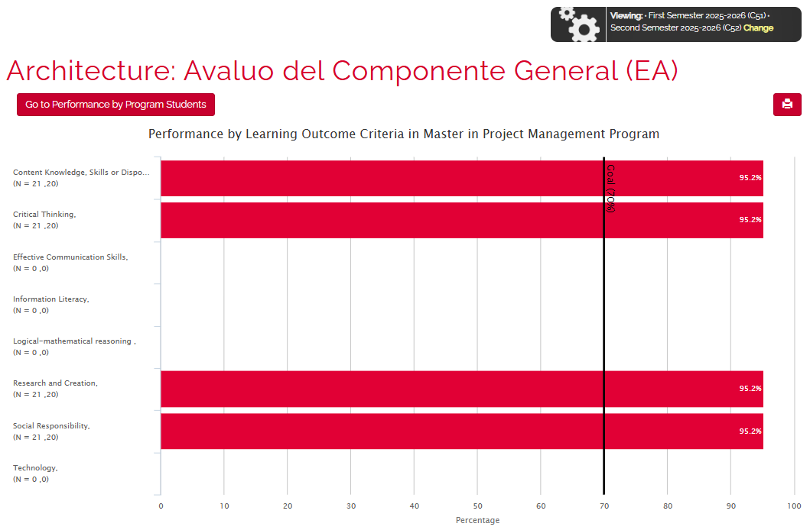
Architecture: Avalúo del Componente General
(C51 & C52)
Ir a inicio
14

Slide 25
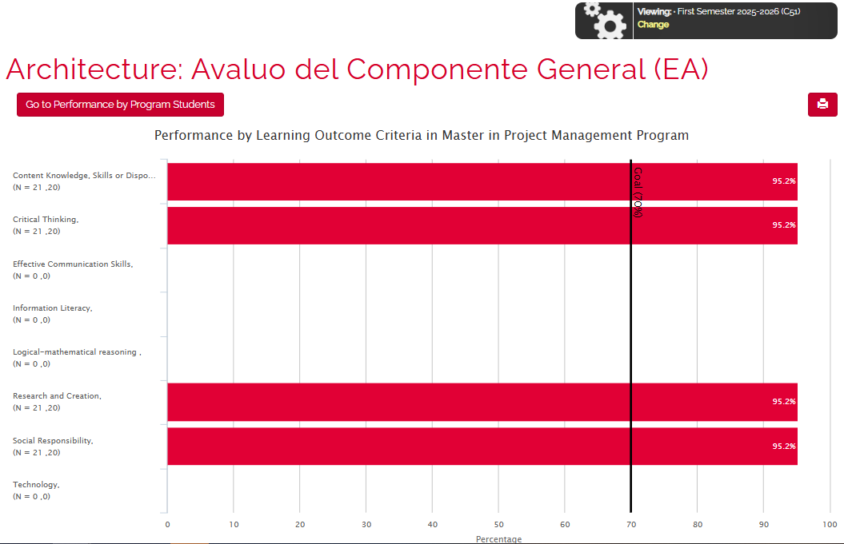
Architecture: Avalúo del Componente General (C51)
Ir a inicio
14

Slide 26
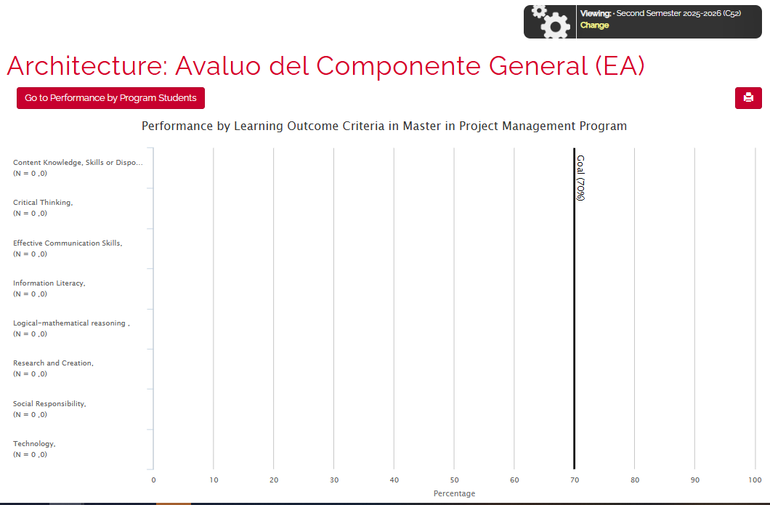
Architecture: Avalúo del Componente General (C52)
Ir a inicio
14

Slide 27

Ir a inicio
Natural Sciences
2025-2026
15

Slide 28
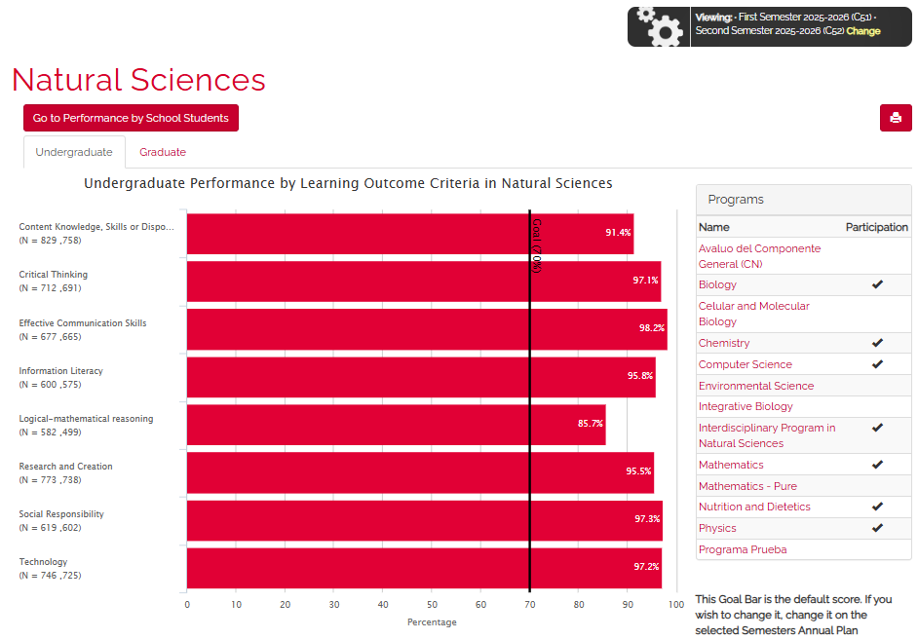
College/school results: Natural Sciences (C51 & C52)
Ir a inicio
16

Slide 29
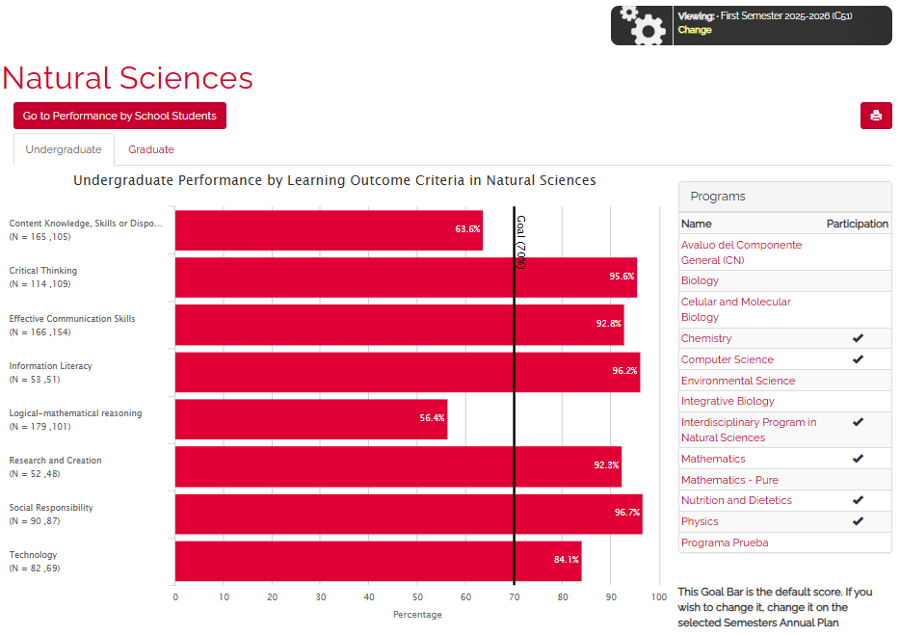
College/school results: Natural Sciences (C51)
Ir a inicio
16

Slide 30
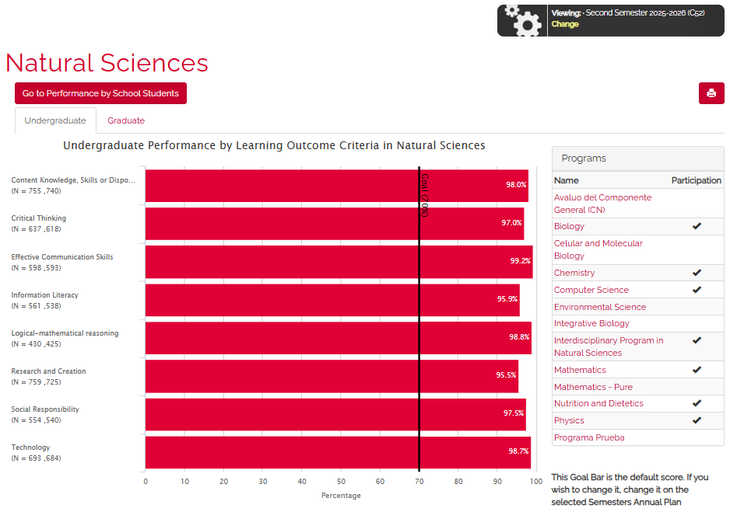
College/school results: Natural Sciences (C52)
Ir a inicio
16

Slide 31
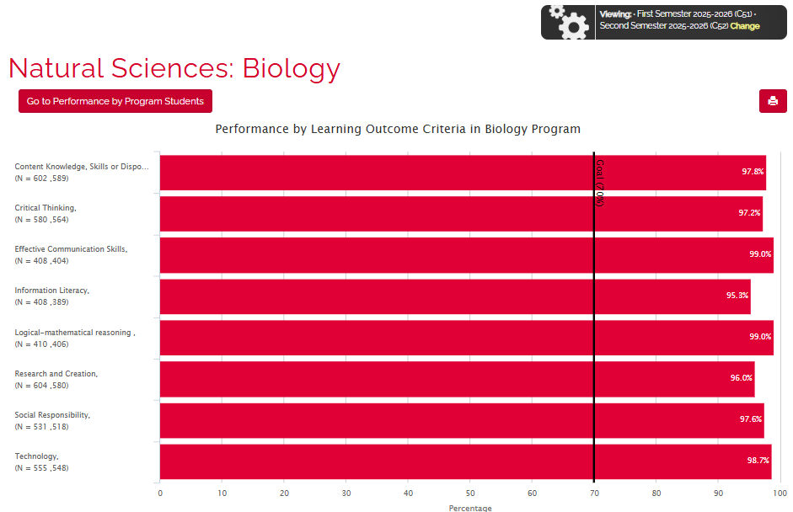
Natural Sciences: Biology (C51 & C52)
Ir a inicio
17

Slide 32
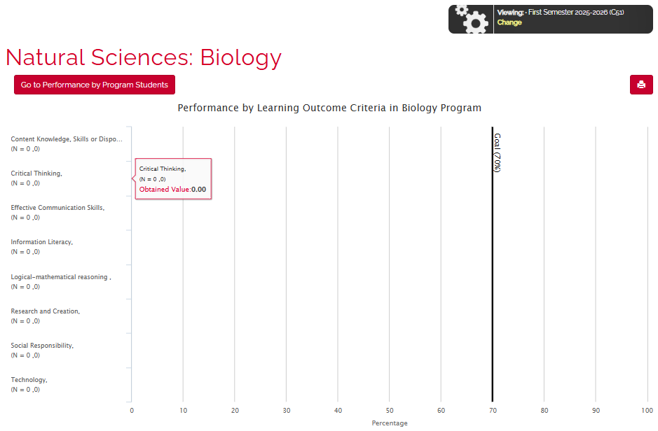
Natural Sciences: Biology (C51)
Ir a inicio
18

Slide 33
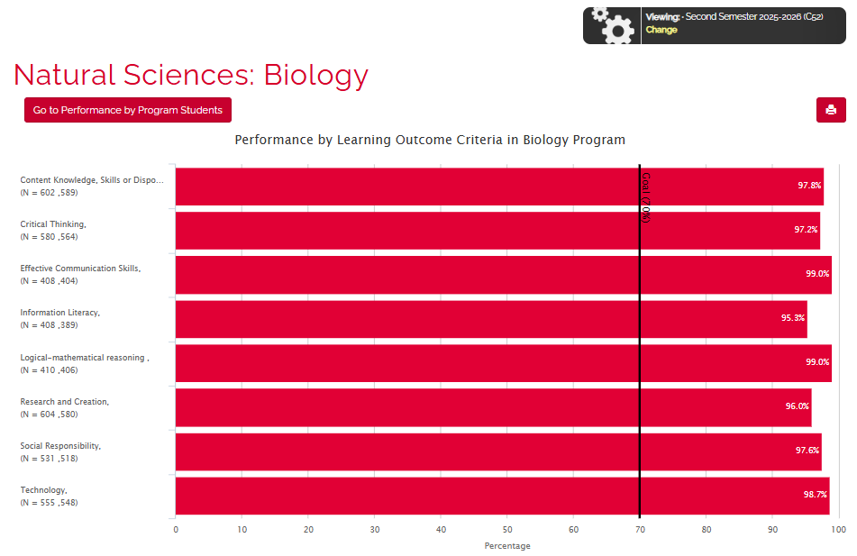
Natural Sciences: Biology (C52)
Ir a inicio
19

Slide 34
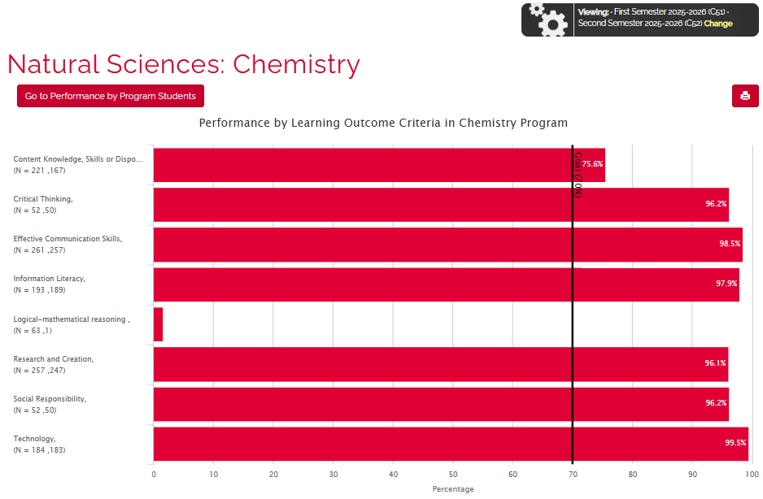
Natural Sciences: Chemistry (C51 & C52)
Ir a inicio
20

Slide 35
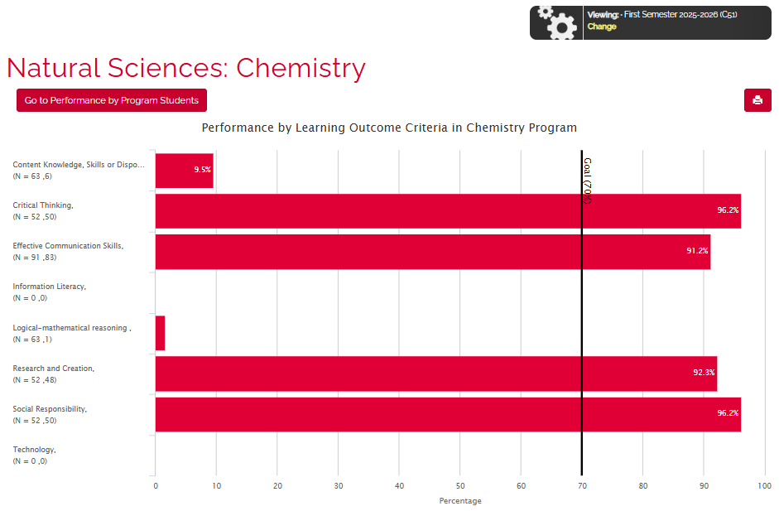
Natural Sciences: Chemistry (C51)
Ir a inicio
21

Slide 36
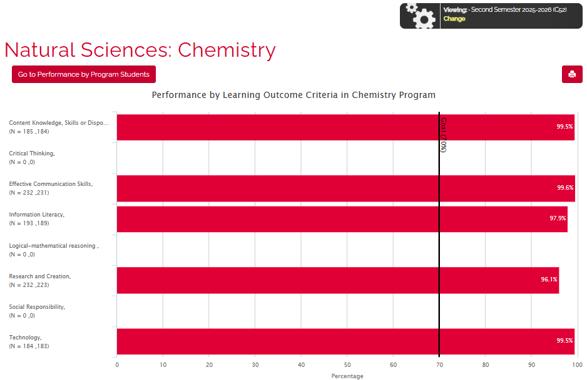
Natural Sciences: Chemistry (C52)
Ir a inicio
22

Slide 37
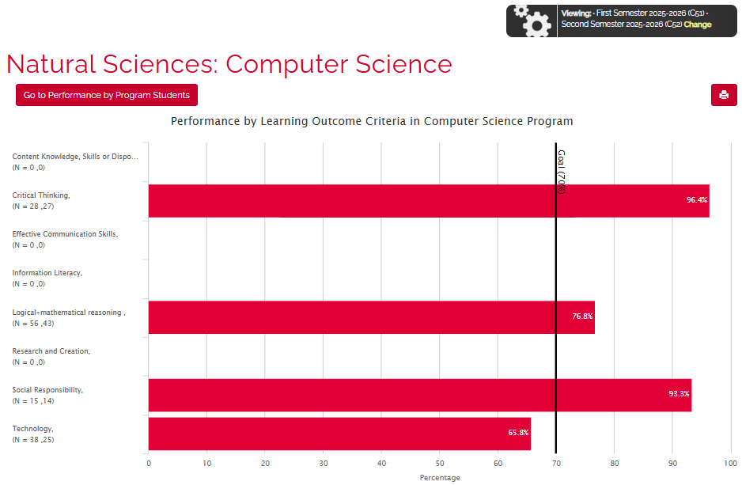
Natural Sciences: Computer Science (C51 & C52)
Ir a inicio
29

Slide 38
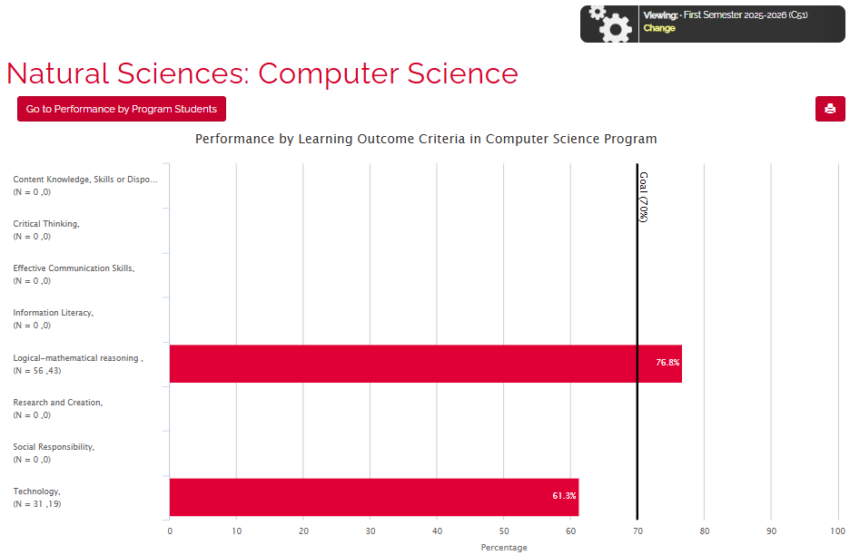
Natural Sciences: Computer Science (C51)
Ir a inicio
30

Slide 39
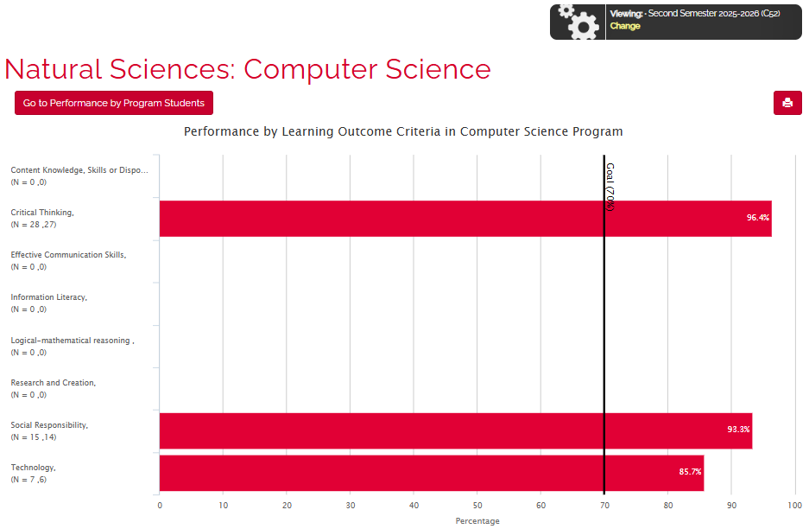
Natural Sciences: Computer Science (C52)
Ir a inicio
31

Slide 40
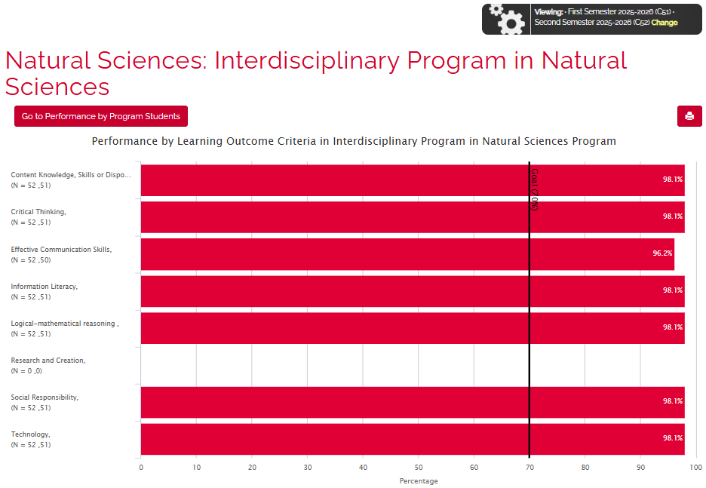
Natural Sciences: Interdisciplinary Program in Natural Sciences
(C51 & C52)
Ir a inicio
31

Slide 41
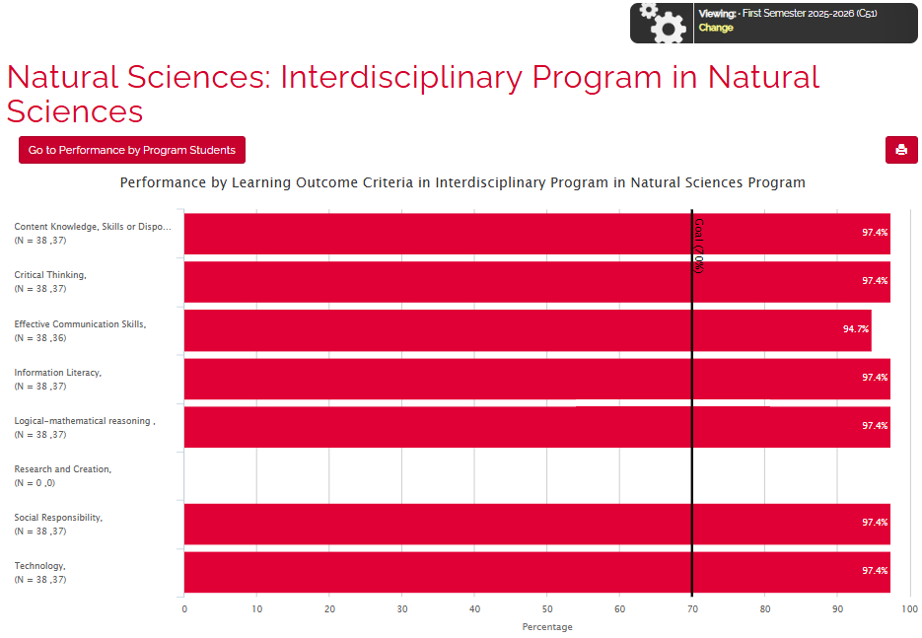
Natural Sciences: Interdisciplinary Program in Natural Sciences
(C51)
Ir a inicio
31

Slide 42
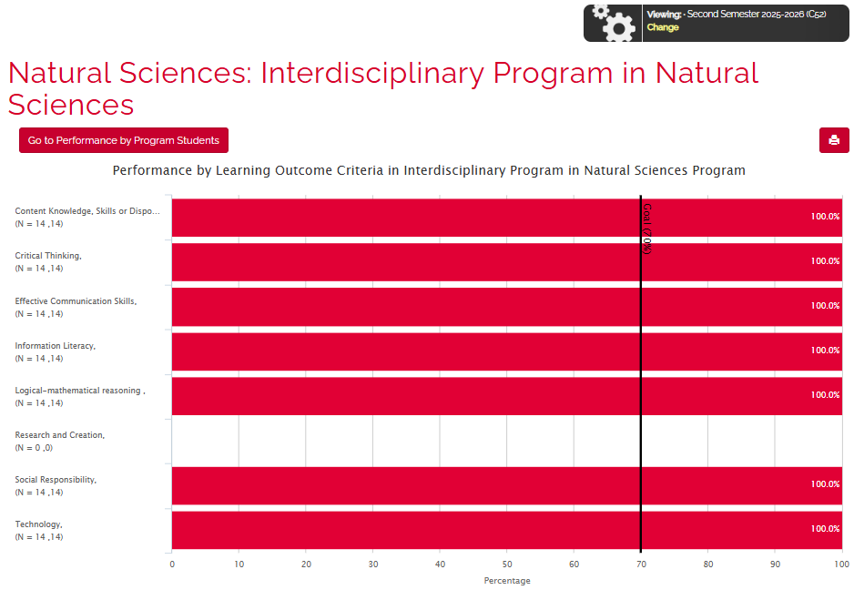
Natural Sciences: Interdisciplinary Program in Natural Sciences
(C52)
Ir a inicio
31

Slide 43
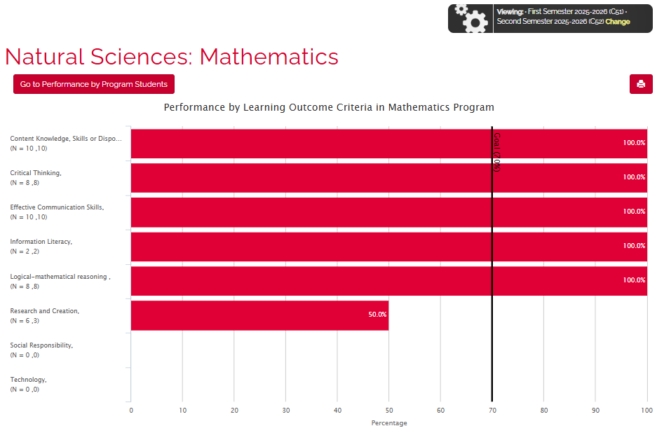
Natural Sciences: Mathematics (C51 & C52)
Ir a inicio
31

Slide 44
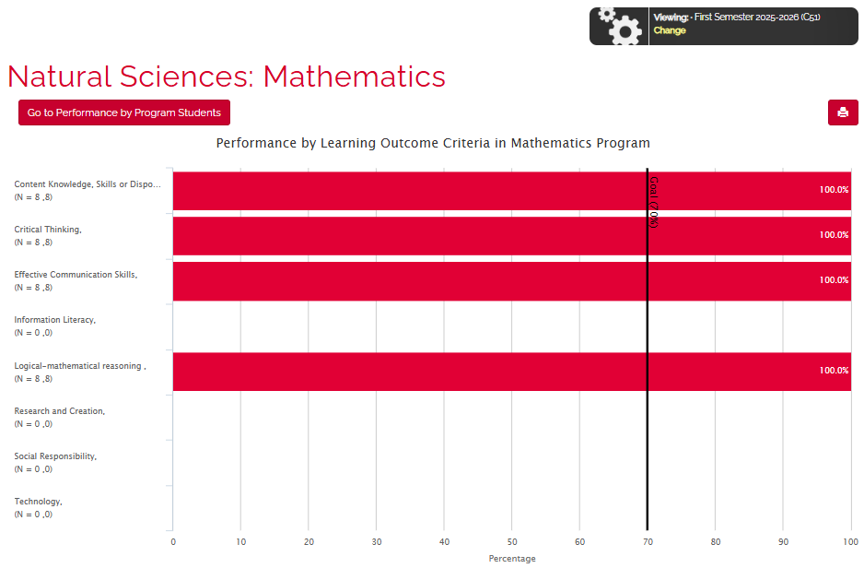
Natural Sciences: Mathematics (C51)
Ir a inicio
31

Slide 45
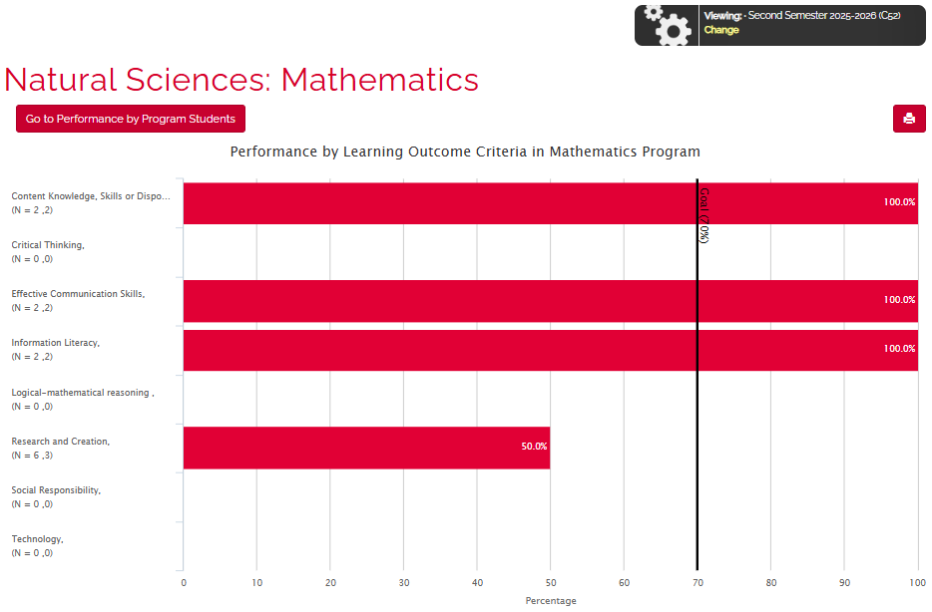
Natural Sciences: Mathematics (C52)
Ir a inicio
31

Slide 46
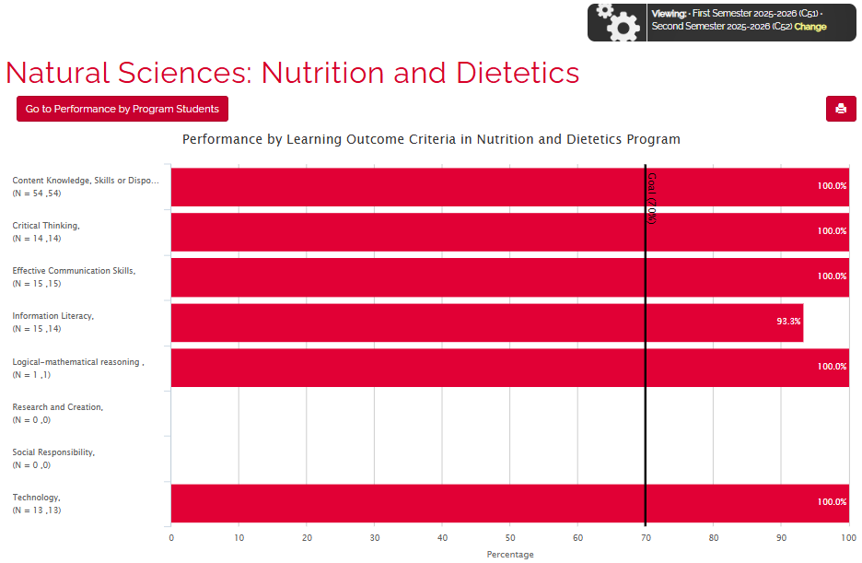
Natural Sciences: Nutrition and Dietetics (C51 & C52)
Ir a inicio
26

Slide 47
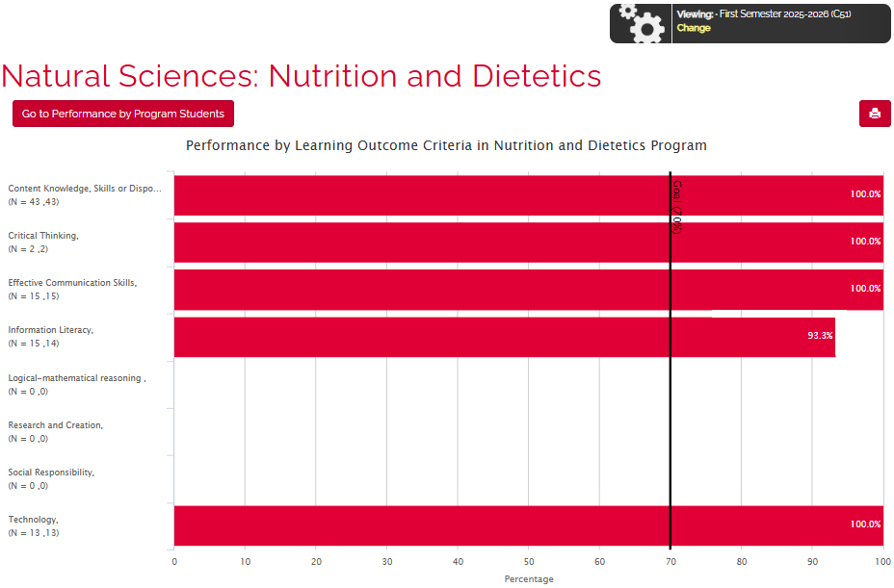
Natural Sciences: Nutrition and Dietetics (C51)
Ir a inicio
27

Slide 48
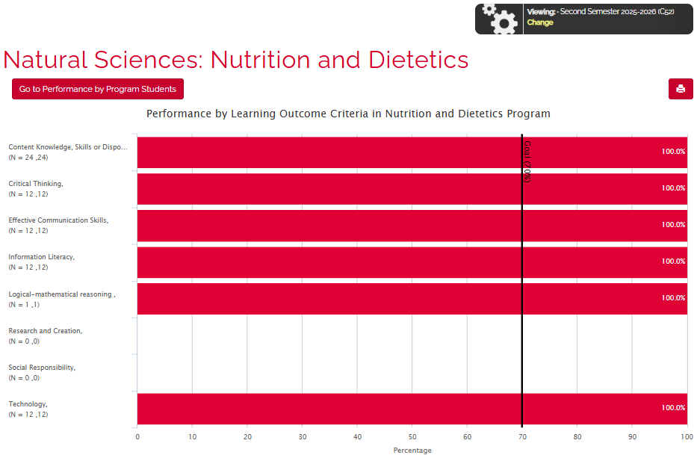
Natural Sciences: Nutrition and Dietetics (C52)
Ir a inicio
28

Slide 49
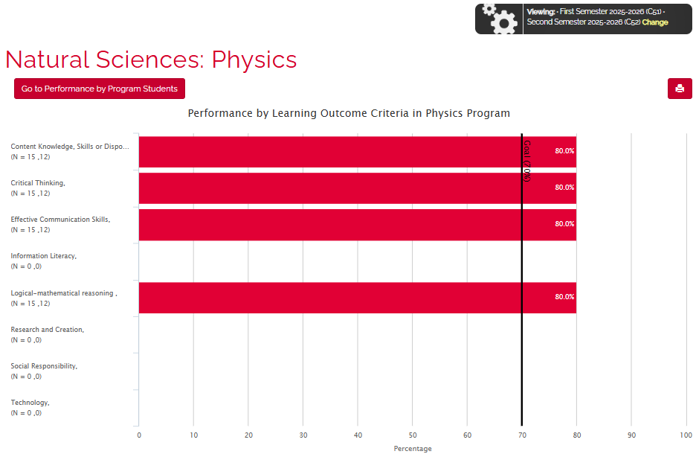
Natural Sciences: Physics (C51 & C52)
Ir a inicio
23

Slide 50
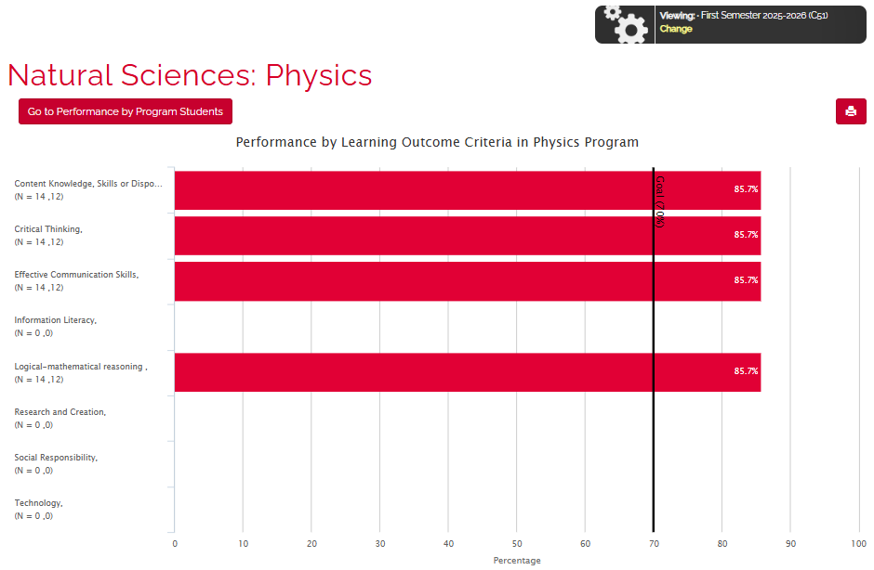
Natural Sciences: Physics (C51)
Ir a inicio
24

Slide 51
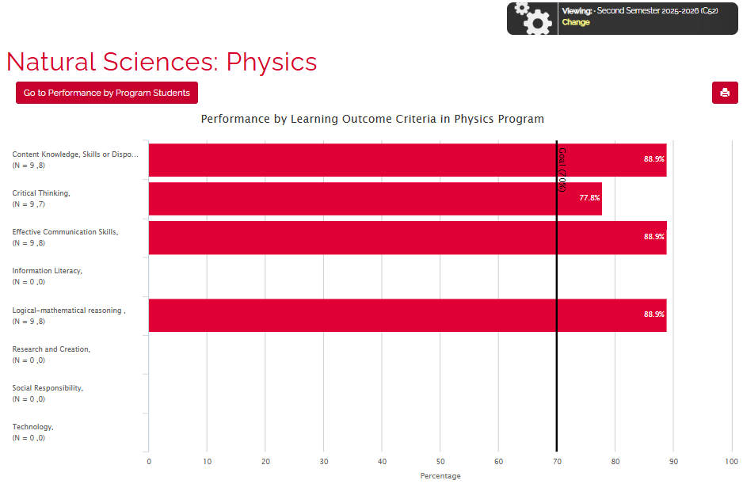
Natural Sciences: Physics (C52)
Ir a inicio
25

Slide 52

Ir a inicio
Social Sciences
2025-2026
32

Slide 53
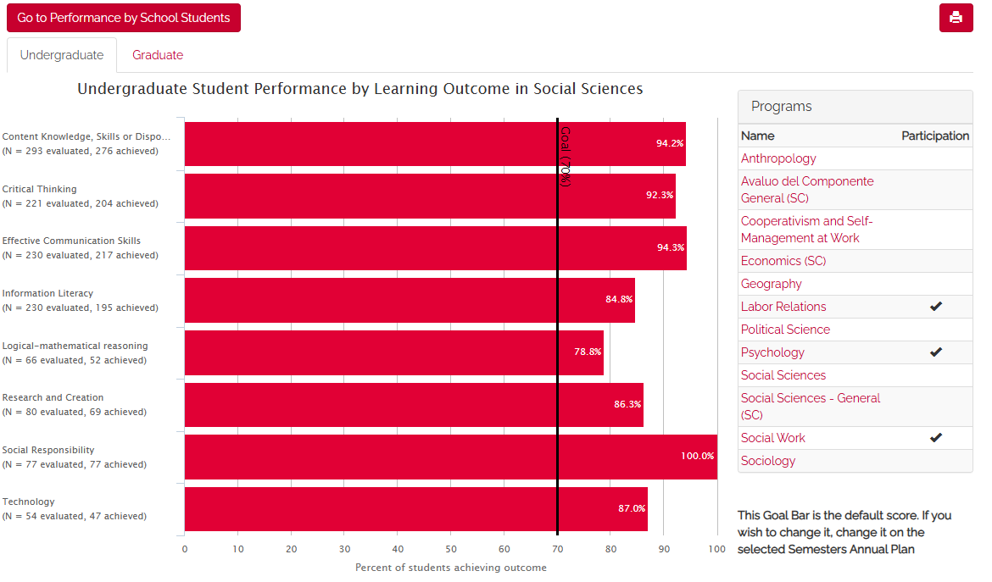
College/school results: Social Sciences (C51 & C52)
Ir a inicio
33

Slide 54
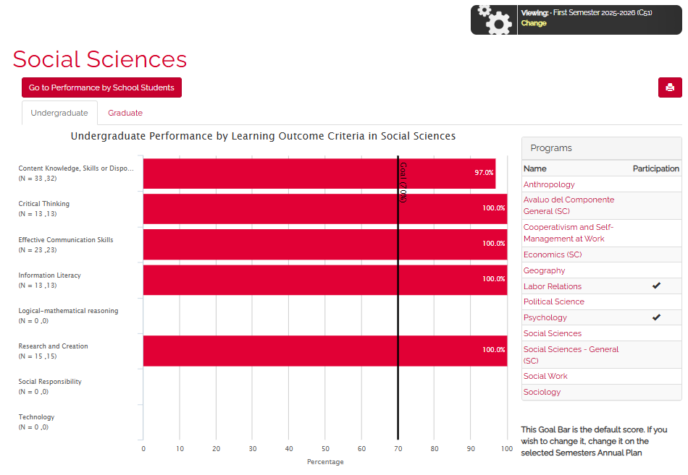
College/school results: Social Sciences (C51)
Ir a inicio
33

Slide 55
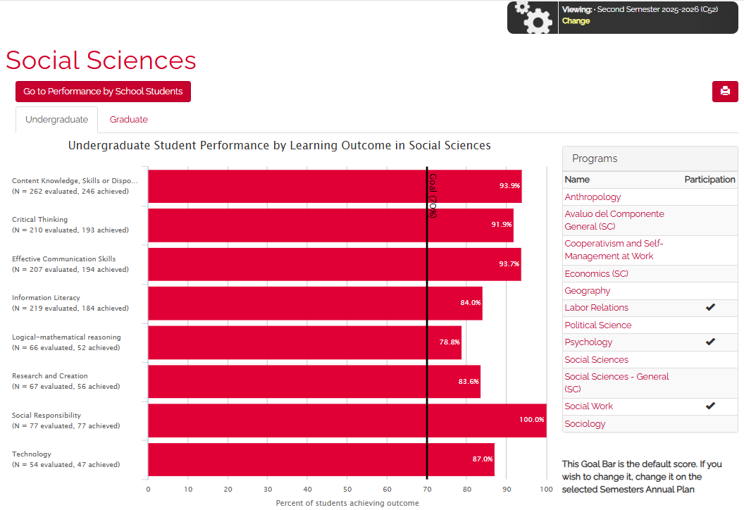
College/school results: Social Sciences (C52)
Ir a inicio
33

Slide 56
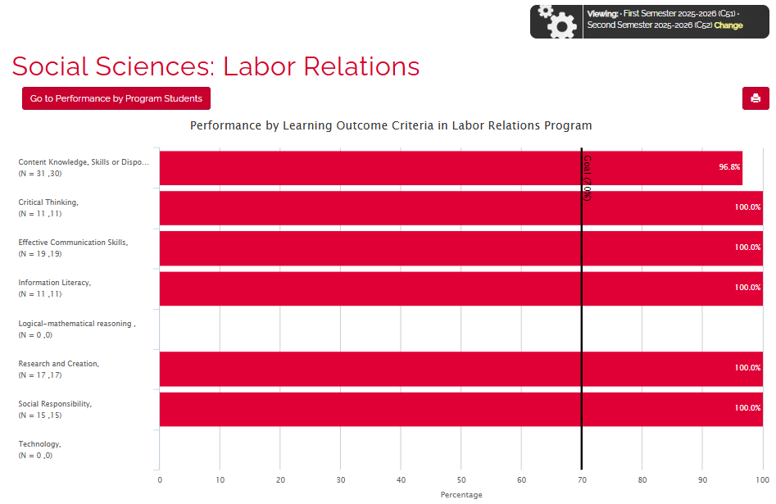
Social Sciences: Labor Relations (C51 & C52)
Ir a inicio
37

Slide 57
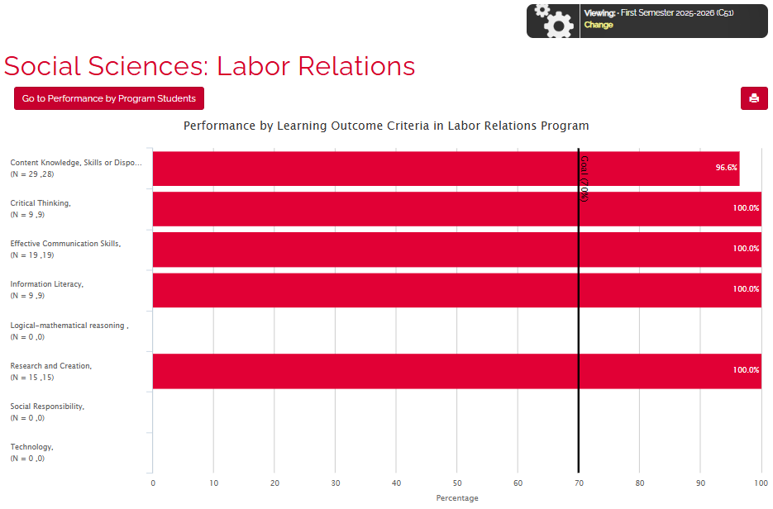
Social Sciences: Labor Relations (C51)
Ir a inicio
38

Slide 58

Social Sciences: Labor Relations (C52)
Ir a inicio
39

Slide 59

Social Sciences: Psychology (C51 & C52)
Ir a inicio
34

Slide 60

Social Sciences: Psychology (C51)
Ir a inicio
35

Slide 61

Social Sciences: Psychology (C52)
Ir a inicio
36

Slide 62

Social Sciences: Social Work (C51 & C52)
Ir a inicio
34

Slide 63

Social Sciences: Social Work (C51)
Ir a inicio
35

Slide 64

Social Sciences: Social Work (C52)
Ir a inicio
36

Slide 65

Ir a inicio
General Studies
2025-2026
40

Slide 66

College/school results: General Studies (C51 y C52)
Ir a inicio
41

Slide 67

College/school results: General Studies (C51)
Ir a inicio
41

Slide 68

College/school results: General Studies (C52)
Ir a inicio
41

Slide 69

General Studies: Avalúo del Componente General (C51 y C52)
Ir a inicio
42

Slide 70

General Studies: Avalúo del Componente General (C51)
Ir a inicio
42

Slide 71

General Studies: Avalúo del Componente General (C52)
Ir a inicio
42

Slide 72

Ir a inicio
Communication and Information
2025-2026
51

Slide 73

College/school results: Communication and Information (C51 & C52)
Ir a inicio
52

Slide 74

College/school results: Communication and Information (C51)
Ir a inicio
52

Slide 75

College/school results: Communication and Information (C52)
Ir a inicio
52

Slide 76

Communication and Information: Core Courses of School of Communication (C51 & C52)
Ir a inicio
56

Slide 77

Communication and Information: Core Courses of School of Communication (C51)
Ir a inicio
57

Slide 78

Communication and Information: Core Courses of School of Communication (C52)
Ir a inicio
58

Slide 79

Communication and Information: Audiovisual Communication (C51 & C52)
Ir a inicio
53

Slide 80

Communication and Information: Audiovisual Communication (C51)
Ir a inicio
54

Slide 81

Communication and Information: Audiovisual Communication (C52)
Ir a inicio
55

Slide 82

Communication and Information: Information and Journalism (C51 & C52)
Ir a inicio
59

Slide 83

Communication and Information: Information and Journalism (C51)
Ir a inicio
60

Slide 84

Communication and Information: Information and Journalism (C52)
Ir a inicio
61

Slide 85

Communication and Information: Public Relations and Advertisement (C51 & C52)
Ir a inicio
62

Slide 86

Communication and Information: Public Relations and
Advertisement (C51)
Ir a inicio
63

Slide 87

Communication and Information: Public Relations and
Advertisement (C52)
Ir a inicio
64

Slide 88

Ir a inicio
Humanities
2025-2026
65

Slide 89

College/school results: Humanities (C51 & C52)
Ir a inicio
66

Slide 90

College/school results: Humanities (C51)
Ir a inicio
66

Slide 91

College/school results: Humanities (C52)
Ir a inicio
66

Slide 92

Humanities: Avalúo del Componente General (C51 & C52)
Ir a inicio
42

Slide 93

Humanities: Avalúo del Componente General (C51)
Ir a inicio
42

Slide 94

Humanities : Avalúo del Componente General (C52)
Ir a inicio
42

Slide 95

Humanities: Art History (C51 & C52)
Ir a inicio
67

Slide 96

Humanities: Art History (C51)
Ir a inicio
67

Slide 97

Humanities: Art History (C52)
Ir a inicio
67

Slide 98

Humanities: Bachelor Arts in English (C51 & C52)
Ir a inicio
67

Slide 99

Humanities: Bachelor Arts in English (C51)
Ir a inicio
67

Slide 100

Humanities: Bachelor Arts in English (C52)
Ir a inicio
67

Slide 101

Humanities: Comparative Literature (C51 & C52)
Ir a inicio
67

Slide 102

Humanities: Comparative Literature (C51)
Ir a inicio
67

Slide 103

Humanities: Comparative Literature (C52)
Ir a inicio
67

Slide 104

Humanities: Fine Arts (C51 & C52)
Ir a inicio
67

Slide 105

Humanities: Fine Arts (C51)
Ir a inicio
68

Slide 106

Humanities: Fine Arts (C52)
Ir a inicio
69

Slide 107

Humanities: Hispanic Studies (C51 & C52)
Ir a inicio
67

Slide 108

Humanities: Hispanic Studies (C51)
Ir a inicio
67

Slide 109

Humanities: Hispanic Studies (C52)
Ir a inicio
67

Slide 110

Humanities: History (C51 & C52)
Ir a inicio
67

Slide 111

Humanities: History (C51)
Ir a inicio
67

Slide 112

Humanities: History (C52)
Ir a inicio
67

Slide 113

Humanities: Modern/Foreign Languages (C51 & C52)
Ir a inicio
67

Slide 114

Humanities: Modern/Foreign Languages (C51)
Ir a inicio
67

Slide 115

Humanities: Modern/Foreign Languages (C52)
Ir a inicio
67

Slide 116

Humanities: Music (C51 & C52)
Ir a inicio
67

Slide 117

Humanities: Music (C51)
Ir a inicio
67

Slide 118

Humanities: Music (C52)
Ir a inicio
67

Slide 119

End of the OLAS Participation Report 2025–2026.
Ir a inicio
94
Dr. Emmanuel Ocasio Acevedo
Institutional Coordinator for Student Learning Assessment
Undergraduate Level

Slide 120



Thanks for your commitment
95

